Slide 1
INSUREALL PROJECT
TEAM 10 THEEPA SHREE K VAISHNAVI S

Slide 2



USE CASE
ONE PLACE FOR INSURANCE
PERSONAS ADMIN CUSTOMER

Slide 3

CUSTOMER FEATURES
Policy Details Viewing Customers can view detailed information about their policies, including terms, conditions, and coverage specifics. Policy Status Viewing Customers can easily view the status of their insurance policies, including coverage details, renewal dates, and any pending actions. Premium Calculator The website includes a premium calculator that allows customers to estimate their insurance premiums based on various factors and coverage options. Payment Processing Customers can proceed to pay their term amounts directly through the platform, ensuring a seamless and secure payment experience. Feedback Section Customers can provide feedback through a dedicated section, helping to improve services and customer satisfaction.

Slide 4

ADMIN FEATURES
Document Review and Decision Admins have the capability to view submitted documents and either approve or reject insurance applications based on the provided information. Client Management Admins can access and manage all client details, ensuring efficient handling of customer information and support. Policy Management for Admins Admins can manipulate policy details by adding new policies, editing existing ones, and deleting policies as needed. Feedback Viewing for Admins Admins can view feedback from customers to address concerns and improve service quality.

Slide 5
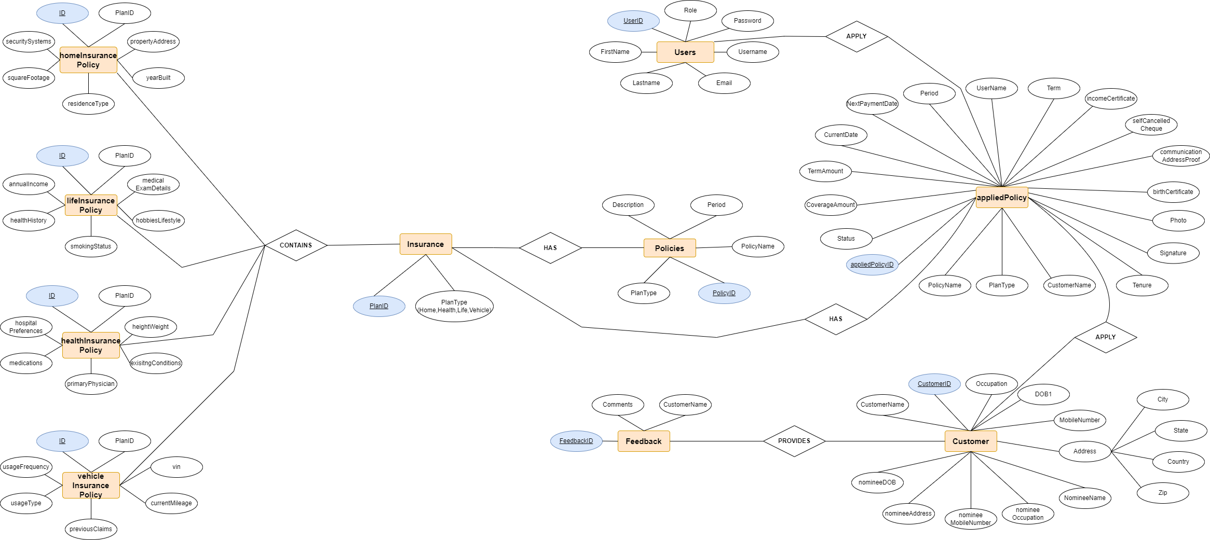
ER DIAGRAM

Slide 6
TECH STACK
Frontend
- React.js: For building dynamic user interfaces.
- Slick Carousel: For implementing carousel components.
Backend
- Spring Boot: For robust backend services.
- Spring Security: For authentication and authorization.
- MySQL: For database management.
APIs
- RESTful APIs: For communication between frontend and backend.
Tools & Libraries
- Lombok: To reduce boilerplate code.
- Gradle: For build and dependency management.

Slide 7
Thank You

